Slide 1
Sepsis is:
the body’s extreme response to an infection. [1]
Notes:
https://www.cdc.gov/sepsis/what-is-sepsis.html#:~:text=Sepsis%20is%20the%20body's%20extreme,%2C%20skin%2C%20or%20gastrointestinal%20tract.

Slide 2
Sepsis is:
the body’s extreme response to an infection. [1]
a life-threatening organ dysfunction caused by a dysregulated host response to infection. [2]
Notes:
2. https://www.who.int/news-room/fact-sheets/detail/sepsis

Slide 3
Sepsis is:
the body’s extreme response to an infection. [1]
a life-threatening organ dysfunction caused by a dysregulated host response to infection. [2]
a potentially life-threatening condition that occurs when the body's response to an infection damages its own tissues. [3]
Notes:
3. https://www.mayoclinic.org/diseases-conditions/sepsis/symptoms-causes/syc-20351214

Slide 4
Sepsis is:
the body’s extreme response to an infection. [1]
a life-threatening organ dysfunction caused by a dysregulated host response to infection. [2]
a potentially life-threatening condition that occurs when the body's response to an infection damages its own tissues. [3]
the body’s overwhelming and life-threatening response to infection that can lead to tissue damage, organ failure, and death. [4]
Notes:
4. https://www.sepsis.org/sepsis-basics/what-is-sepsis/

Slide 5
Sepsis is:
the body’s extreme response to an infection. [1]
a life-threatening organ dysfunction caused by a dysregulated host response to infection. [2]
a potentially life-threatening condition that occurs when the body's response to an infection damages its own tissues. [3]
the body’s overwhelming and life-threatening response to infection that can lead to tissue damage, organ failure, and death. [4]

Slide 6
Sepsis is:
the body’s extreme response to an infection. [1]
a life-threatening organ dysfunction caused by a dysregulated host response to infection. [2]
a potentially life-threatening condition that occurs when the body's response to an infection damages its own tissues. [3]
the body’s overwhelming and life-threatening response to infection that can lead to tissue damage, organ failure, and death. [4]

Slide 7
Sepsis is:
a life-threatening organ dysfunction caused by a dysregulated host response to infection.

Slide 8


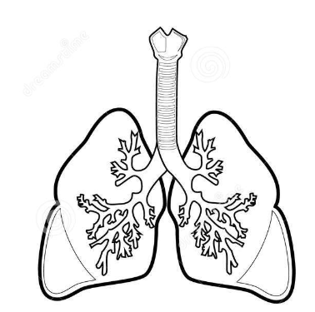

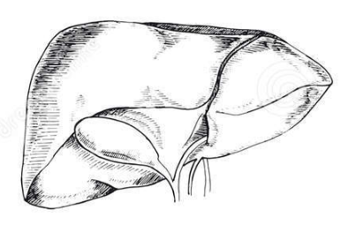
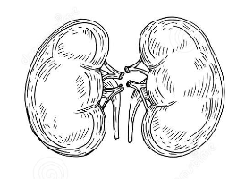
Sepsis is:
a life-threatening organ dysfunction caused by a dysregulated host response to infection.

Slide 9
Glasgow Coma Scale (GCS)
Mean Arterial Pressure (MAP)
Platelets
PaO2/FIO2
Creatinine
Bilirubin

Slide 10
Glasgow Coma Scale (GCS)
0 1 2 3 4
Mean Arterial Pressure (MAP)
0 1 2 3 4
Platelets
0 1 2 3 4
PaO2/FIO2
0 1 2 3 4
Creatinine
0 1 2 3 4
Bilirubin
0 1 2 3 4

Slide 11
Sequential [Sepsis-Related] Organ Failure Assessment Score
Glasgow Coma Scale (GCS)
Sepsis is defined as life-threatening organ dysfunction caused by a dysregulated host response to infection.
0 1 2 3 4
Mean Arterial Pressure (MAP)
0 1 2 3 4
Organ dysfunction can be identified as an acute change in total SOFA score ≥2 points consequent to the infection.
Platelets
0 1 2 3 4
PaO2/FIO2
0 1 2 3 4
Creatinine
0 1 2 3 4
Bilirubin
0 1 2 3 4
Notes:
https://www.ncbi.nlm.nih.gov/pmc/articles/PMC4968574/

Slide 12

Sequential [Sepsis-Related] Organ Failure Assessment Score
Glasgow Coma Scale (GCS)
0 1 2 3 4
Mean Arterial Pressure (MAP)
0 1 2 3 4
https://t.ly/Zt5E
Platelets
0 1 2 3 4
PaO2/FIO2
0 1 2 3 4
Creatinine
0 1 2 3 4
Bilirubin
0 1 2 3 4

Slide 13
Sequential [Sepsis-Related] Organ Failure Assessment Score
Glasgow Coma Scale (GCS)
0 1 2 3 4
Mean Arterial Pressure (MAP)
0 1 2 3 4
Apply this and explore the domain to derive smart relevant features
https://t.ly/Zt5E
Platelets
0 1 2 3 4
PaO2/FIO2
0 1 2 3 4
Creatinine
0 1 2 3 4
Bilirubin
0 1 2 3 4

Slide 14
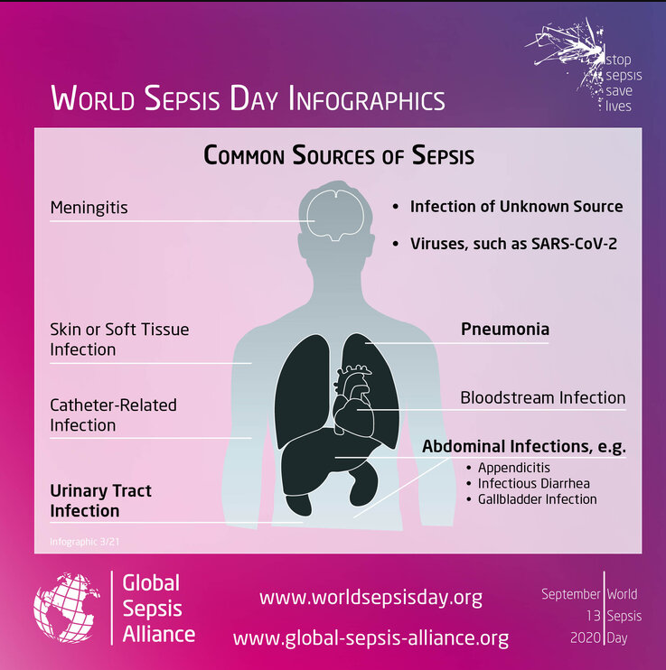
Notes:
https://www.global-sepsis-alliance.org/sepsis#:~:text=Sepsis%20%2D%20A%20global%20Health%20Crisis&text=It%20affects%20between%2047%20and,one%20death%20every%202.8%20seconds.

Slide 15
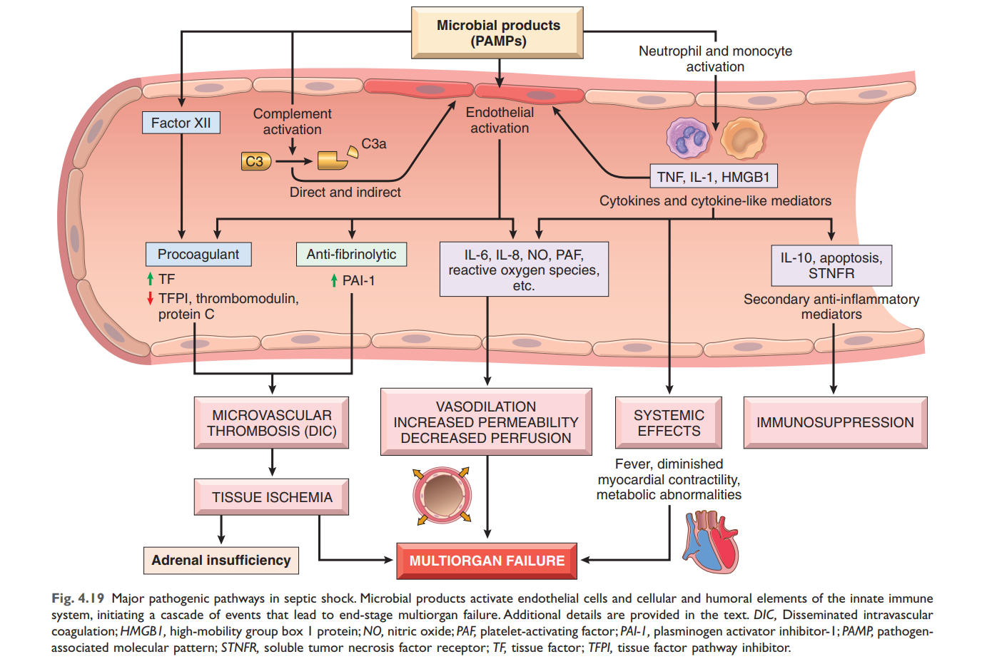
Notes:
Robbins Essential Pathology
Author(s):Vinay Kumar, Abul K. Abbas, Jon C. Aster, Andrea T. Deyrup
ISBN: 9780323640251

Slide 16
Stuff produced by bacteria

Slide 17
Innumerable tiny clots in smaller blood vessels

Slide 18
Innumerable tiny clots in smaller blood vessels
This leads to loss of blood supply to the organs

Slide 19
Blood vessels become very leaky and start oozing fluid into tissues
Innumerable tiny clots in smaller blood vessels
This leads to loss of blood supply to the organs

Slide 20
Fever, decreased ability to pump blood, decreasing pH of blood
Blood vessels become very leaky and start oozing fluid into tissues
Innumerable tiny clots in smaller blood vessels
This leads to loss of blood supply to the organs

Slide 21
Fever, decreased ability to pump blood, decreasing pH of blood
Blood vessels become very leaky and start oozing fluid into tissues
Decreased ability to defend itself against infection
Innumerable tiny clots in smaller blood vessels
This leads to loss of blood supply to the organs

Slide 22
Fever, decreased ability to pump blood, decreasing pH of blood
Blood vessels become very leaky and start oozing fluid into tissues
Decreased ability to defend itself against infection
Innumerable tiny clots in smaller blood vessels
This leads to loss of blood supply to the organs
Major organs (Heart, Kidney, Lung, Brain etc.) start failing, setting up an irreversible downward spiral

Slide 23
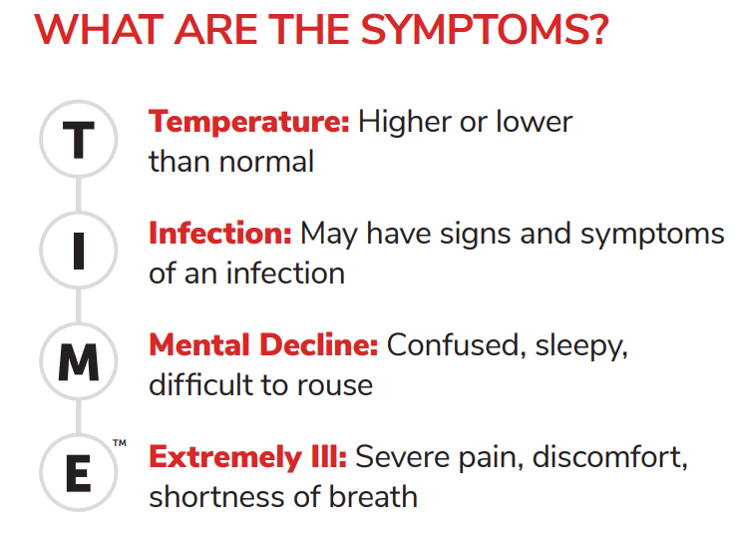
Notes:
https://www.sepsis.org/sepsis-basics/what-is-sepsis/

Slide 24
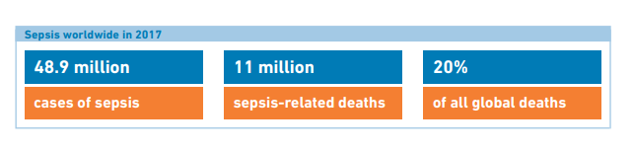
Notes:
Source: https://apps.who.int/iris/bitstream/handle/10665/334216/9789240010789-eng.pdf

Slide 25
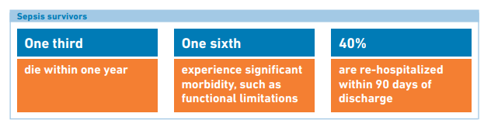
Notes:
Source: https://apps.who.int/iris/bitstream/handle/10665/334216/9789240010789-eng.pdf

Slide 26





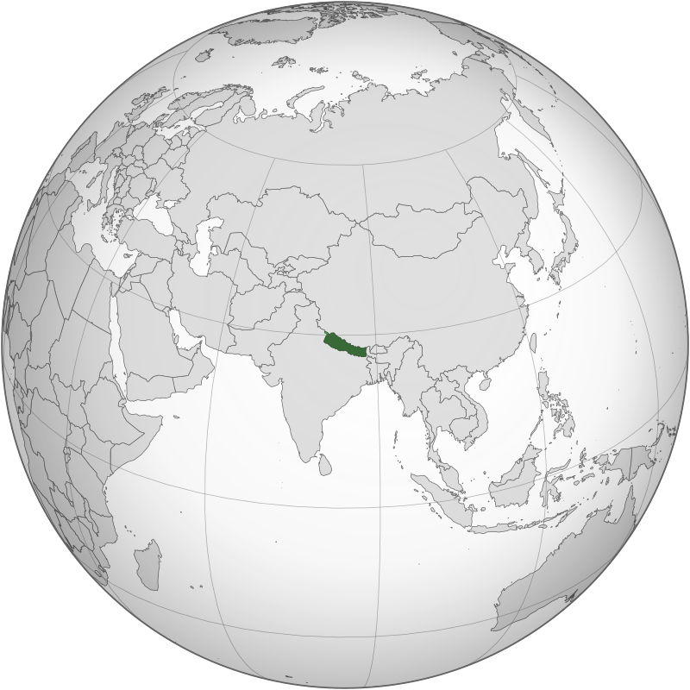
45,195,774
43,851,044
37,846,611
25,499,884
37,742,154
29,136,808
Notes:
Source: https://www.worldometers.info/world-population/population-by-country/

Slide 27
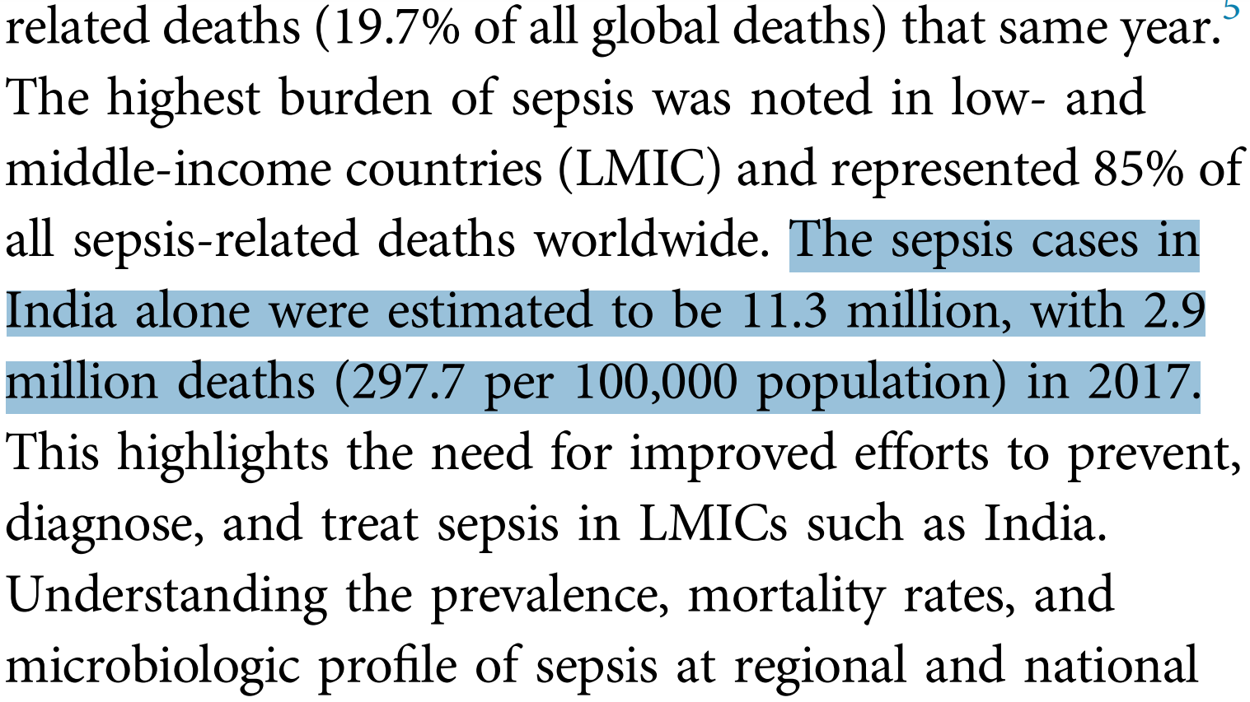
Notes:
https://journal.chestnet.org/article/S0012-3692(22)00254-9/pdf

Slide 28
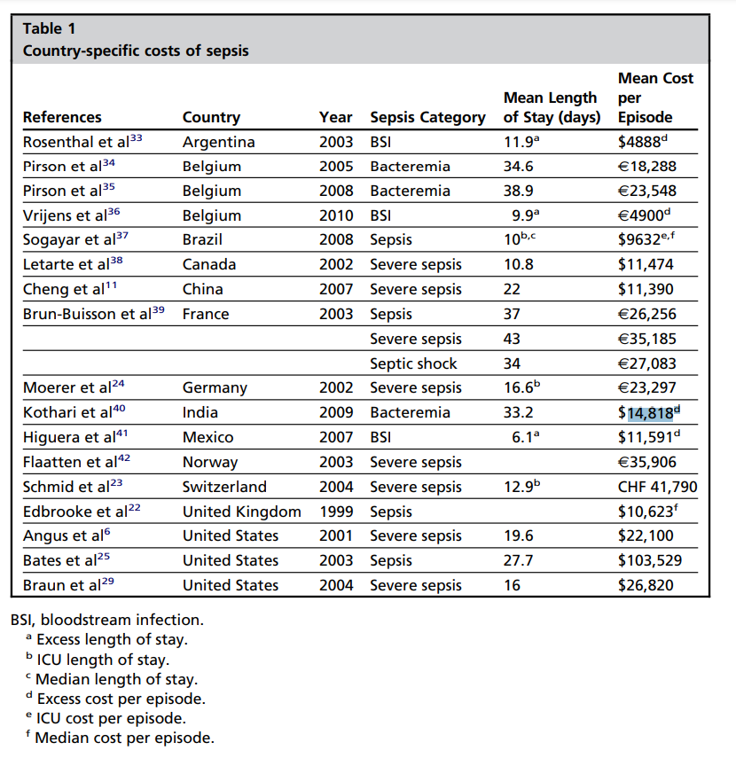
Notes:
Review
Crit Care Clin
. 2012 Jan;28(1):57-76, vi.
doi: 10.1016/j.ccc.2011.09.003.
The economics of sepsis
Andrew N Chalupka ¹, Daniel Talmor
Affiliations expand
PMID: 22123099
DOI: 10.1016/j.ccc.2011.09.003

Slide 29
$16.5 billion
Notes:
Review
Crit Care Clin
. 2012 Jan;28(1):57-76, vi.
doi: 10.1016/j.ccc.2011.09.003.
The economics of sepsis
Andrew N Chalupka ¹, Daniel Talmor
Affiliations expand
PMID: 22123099
DOI: 10.1016/j.ccc.2011.09.003

Slide 30
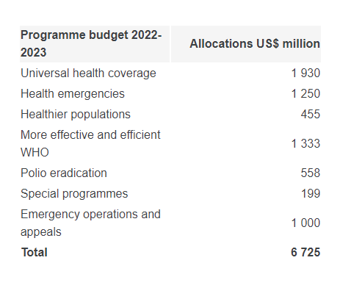

Notes:
https://www.who.int/about/accountability/budget

Slide 31
$ 6.7 Billion

Slide 32
India’s Health and Family welfare budget for 2022-23: Rs. 86,201 Cr.
(~ USD 10.6 Billion)
Notes:
https://prsindia.org/budgets/parliament/union-budget-2022-23-analysis#:~:text=Expenditure%3A%20The%20government%20proposes%20to,8.2%25%20higher%20than%20budget%20estimate.

Slide 33








https://t.ly/JN-j

Slide 34

https://physionet.org/content/challenge-2019/1.0.0/
https://t.ly/JuyN

Slide 35
Project details
Objective: Application of all concepts learnt in ML course
Expected Outcome: Understanding of data science framework and use of all algorithms / techniques (supervised or unsupervised) discussed in class or lab
Submission type: Individual (Attribute the use of any online source; No cheating)
Problem statement: Predict sepsis diagnosis 6 hrs prior to sepsis manifestation
Training set: Use the dataset for hospital 1 as the training and testing set (training_setA)
Validation set: Use the dataset for hospital 2 as the validation set (training_setB)
Deliverables:
Submission of notebook (publicly with bio updated as JI student) on Kaggle
Upload combined pdf of Kaggle score and notebook on Collpoll
Upload csv with prediction (labels-actual & predicted, predicted probability) on Collpoll
Maximum Marks: 100
Marking scheme:
Breadth & depth of use of techniques thought in class/lab in the solution pipeline
Quality of observations and insights highlighted in the notebook
Ease of deployment of model
Any evidence of cheating from friends will fetch (e^{-ɩπ}+1) marks
Bonus Problem statement: Predict sepsis diagnosis 12 hrs prior to sepsis manifestation
Bonus marks are above maximum marks

